Slide 1
Методическая разработка к уроку английского языка
в 9 классе для подготовки к ОГЭ
по теме “Friendship”
Автор: Фомина Наталия Николаевна,
учитель английского языка МАОУ «Лицей №3»

Slide 2
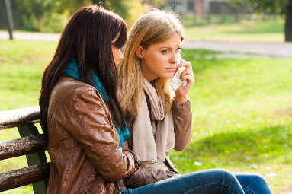
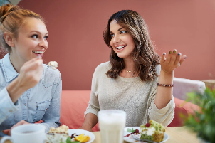
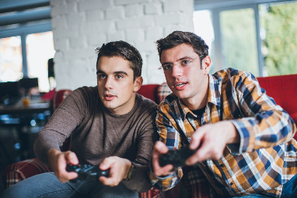
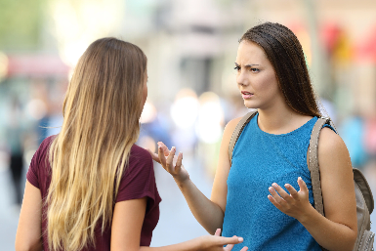
Friendship
Talk about one of your friends. Give as much detail as possible about appearance, personality, when you first met, and what kinds of things you do together.

Slide 3
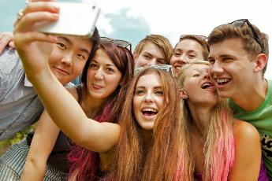
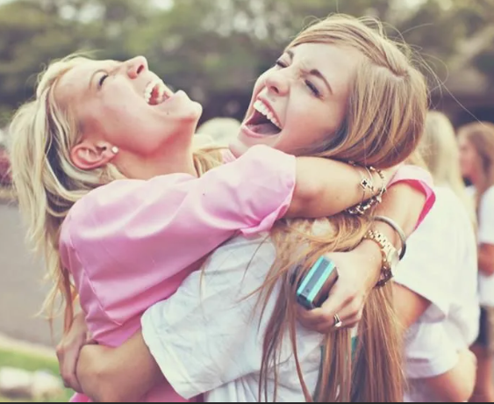
Complete the sentences:
1. A best friend is .............
2. A best friend is a person who always ......................
3. A best friends is a person who never .......................
Use the following ideas:
Tell secrets to
Talk about smb behind their back
Have things in common with
Remember smb’s birthday
Make smb laugh when they are upset
Try to change smb
Keep a promise
Help smb when they have a problem
Tell lies

Slide 4
Definitions:
a. to have a good relationship with someone and enjoy each other's company
b. to make someone feel happier or more positive when they are feeling sad or down
c. to enjoy spending time with someone and engaging in enjoyable activities or experiences
d. to form a relationship with someone based on mutual liking, trust, and support
e. to have an argument or disagreement with someone that causes a rift in the relationship
f. to have similar hobbies or activities that you both enjoy doing together
g. to spend time relaxing or socializing in a casual way, often with friends or acquaintances
h. to share similarities or interests with someone or something else
Match:
Words:
1. make friends
2. share interests
3. get on well with
4. fall out with
5. cheer somebody up
6. have fun together
7. be in common with
8. hang out

Slide 5
Match the words to make phrases:
Left:
1. best
2. get on well
3. know
4. be in
5. share
6. make
7. live
8. cheer
Right:
a. common
b. interests with smb
c. close to
d. smb up
e. with each other
f. friend
g. smb for ages
h. friends

Slide 6
Fill in the gaps with: had, have, hang, with (3), make friends, in, get on well with, up, fun, out (2), common, fell, cheer, share (2)
1. "I want to _____(1) with my new classmates."
2. "John and Mary _____(2) each other because they _____(3) a love of music."
3. "My sister was sad, so I told her a joke to _____(4) her _____(5)."
4. "We both enjoy reading books, so we often _____(6) book recommendations _____(7) each other."
5. "Last weekend, my family _____(8) _____(9) together at the beach."
6. "Tom and Jack _____(10) _____(11) _____(12) each other after an argument about politics."
7. "I realized that I _____(13) many things _____(14) _____(15) _____(16) my neighbor, such as gardening.
8. Students often (17)__________ (18) __________in the cafeteria during lunchtime.

Slide 7
Translations:
a. поссориться с кем-то
b. иметь много общих интересов
c. ладить друг с другом
d. проводить свободное время вместе
e. дать совет
f. жить рядом
g. хорошо проводить время
h. лучший друг
i. заводить друзей
j. разделять интересы
k. знать кого-то целую вечность
l. подбодрить кого-то
Words:
1. spend free time together
2. share interests
3. live close to
4. best friend
5. give a piece of advice
6. have fun
7. make friends
8. cheer smb. up
9. have a lot of common interests
10. fall out with
11. get on well with each other
12. know smb. for ages

Slide 8
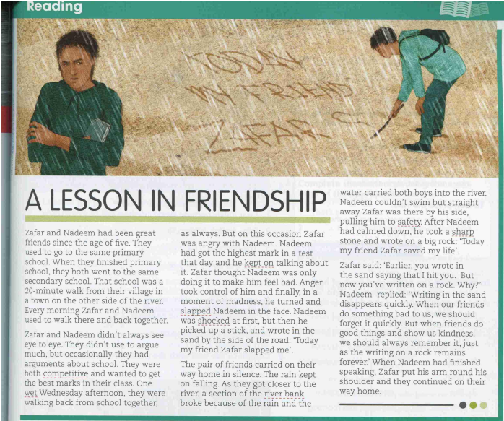
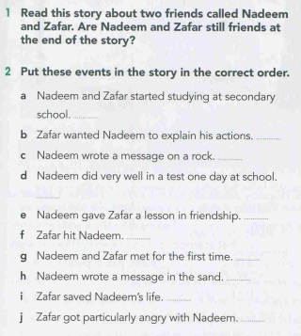
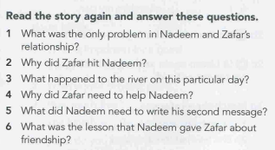
Notes:
Gateway B1 SB Unit 8

Slide 9
Fill in the gaps: interested, comfort, spend, friendship, cheer, leave, common, important, best, parties, for ages, share, introduced.
I’m going to give a talk about my best friend.
There’s no doubt that everybody needs friends and if we can call one of them the ............ friend, it’s even better. We need friends to .............. us when we are sad. A friend is the one who’ll never ................ you alone with all your problems, ............. you up, give you a good piece of advice and always help you. Also, friends usually ............... our interests and we have people to ................ our free time with.
It seems that I have known my best friend................... . I remember the day a saw her/him in our school. She/He moved to our city and didn’t know anybody. I wanted to make her/his first days in our class more comfortable and ................. myself. Since that day we are best friends.
We’ve got a lot of ................ interests. Firstly, we’re .................... in sport and often play football/volleyball/tennis together. Secondly, we both paint and draw well and love spending time drawing or visiting art galleries. Also, as all teenagers in the world we enjoy having .............., and going to the cinema.
I think it’s obvious that ..................... is one of the most ................... things in our life.
I think that’s all that I wanted to tell you about my best friend.

Slide 10
Exam task
What is your best friend like?
And/ person/ best/ kind /Natasha /a /my/ friendly/ is /friend.
2. Where did you and your friend meet for the first time?
Friends/in/we/company/our/met/a/of/common/first.
3. How often do you see each other?
Almost/each/we/every/ see/weekend/other . A/we/walk together/for/go/.
4. What do you like to do together?
Video/and/we/out/watch/clips/hang/together/a lot .
5. What career is your best friend going to follow?
Well, I’m not sure, is/going/be/I/designer/she/a/but/fashion/to/guess.
6. What would you recommend to a teenager who wants to be a good friend?
In my view, to be a good friend, their/should/up/a teenager/cheer/ friend them/moments/in/and/sad/comfort/.

Slide 11
Exam task 35
From: Ann@mail.uk
To: Russian_friend@oge.ru
Subject: My best friend
… Oh, my friend is so charming! Everybody in the class is ready to help her. But, you know, I sometimes think she’s just using people to get what she wants.
…What kind of person is your best friend? When and where did you meet? How do you spend time together?…
Write a message to Ann and answer her 3 questions.
Write 100–120 words.
Remember the rules of letter writing.

